Slide 1
Decision Trees
Basic Concepts

Slide 2
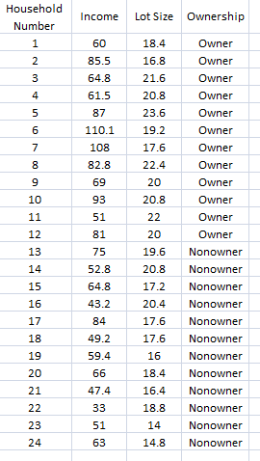

Slide 3
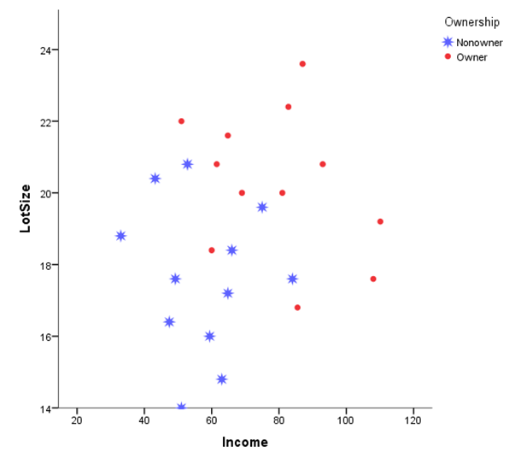

Slide 4
Node 1, Lot Size =19

Slide 5
Node 1, Lot size =19
Node 2,
Income = 84.75

Slide 6
Node 1, Lot size =19
Node 3, Lot size =18
Node 2,
Income = 84.75

Slide 7
Node 4, Lot size =18.6
Node 1, Lot size =19
Node 3, Lot size =18
Node 2,
Income = 84.75

Slide 8
Node 4, Lot size =18.6
Node 1, Lot size =19
Node 5, Income = 62
Node 3, Lot size =18
Node 2,
Income = 84.75

Slide 9
Node 6, Income= 57.6
Node 4, Lot size =18.6
Node 1, Lot size =19
Node 5, Income = 62
Node 3, Lot size =18
Node 2,
Income = 84.75

Slide 10
Node 6, Income= 57.6
Node 7,
Lot Ssze = 21.4
Node 4, Lot size =18.6
Node 1, Lot size =19
Node 5, Income = 62
Node 3, Lot size =18
Node 2,
Income = 84.75

Slide 11
Node 6, Income= 57.6
Node 7,
Lot Ssze = 21.4
Node 8, Lot size =19.8
Node 4, Lot size =18.6
Node 1, Lot size =19
Node 5, Income = 62
Node 3, Lot size =18
Node 2,
Income = 84.75

Slide 12
Node 6, Income= 57.6
Node 7,
Lot Size = 21.4
Node 8, Lot size =19.8
Node 9,
Lot size = 19.4
Node 4, Lot size =18.6
Node 1, Lot size =19
Node 5, Income = 62
Node 3, Lot size =18
Node 2,
Income = 84.75

Slide 13
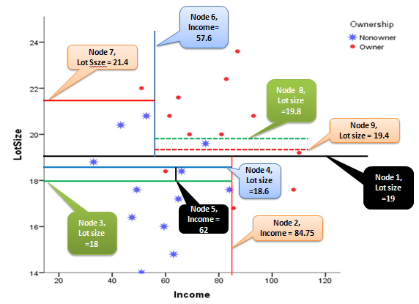
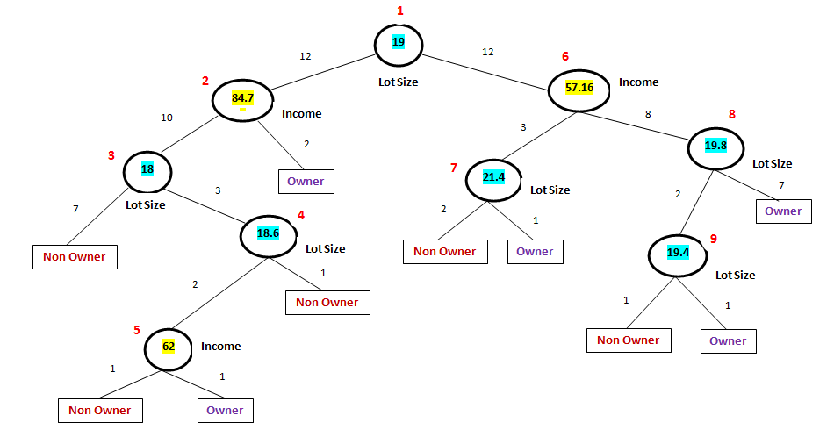

Slide 15
Impurity Gini Index

Slide 16
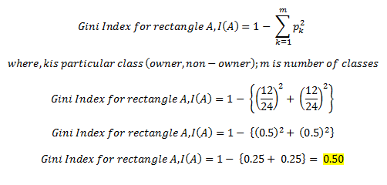
Gini Index before split

Slide 17
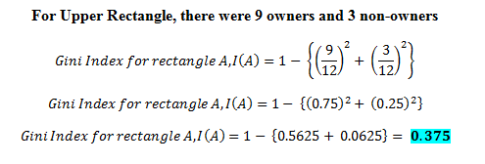
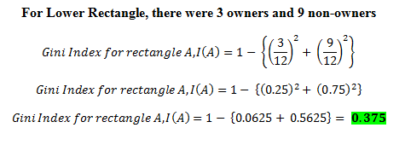
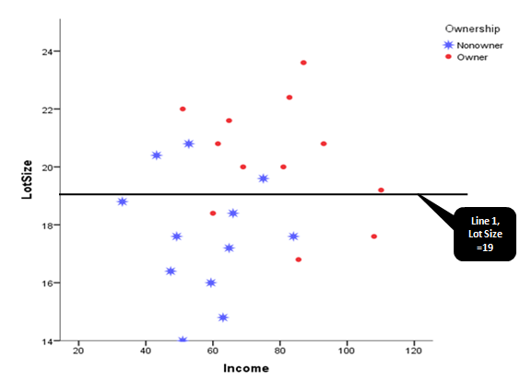
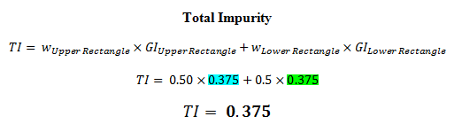
Total
Impurity

Slide 18
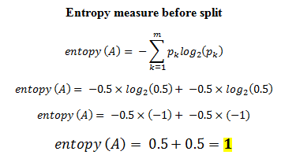
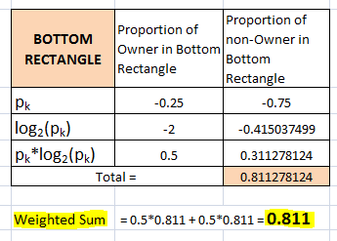
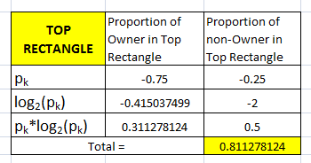
Entropy Measure

Slide 19
Decision Trees Regression & Classification
Data: student

Slide 20
Regression Tree

Slide 21
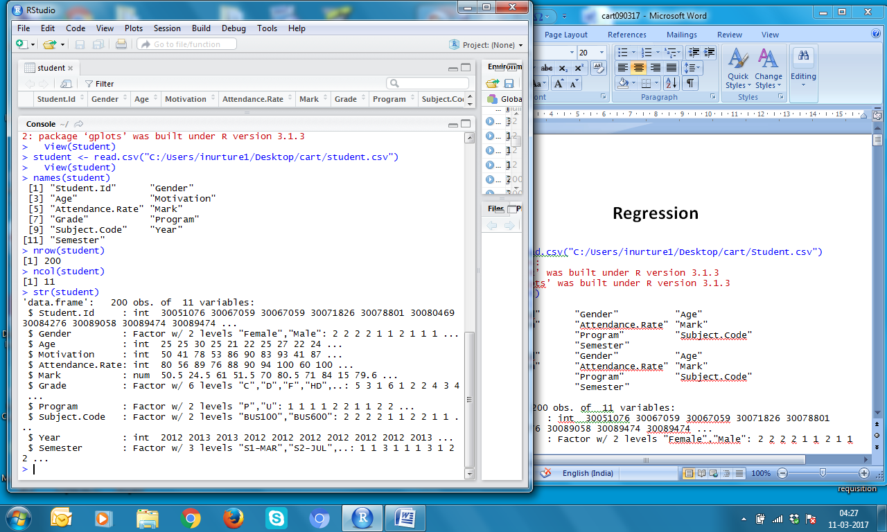

Slide 22
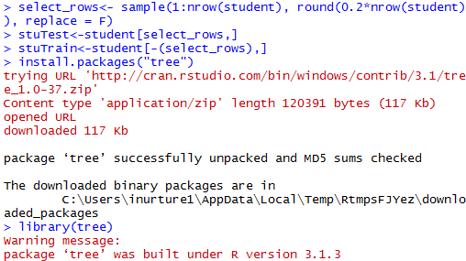

Slide 23
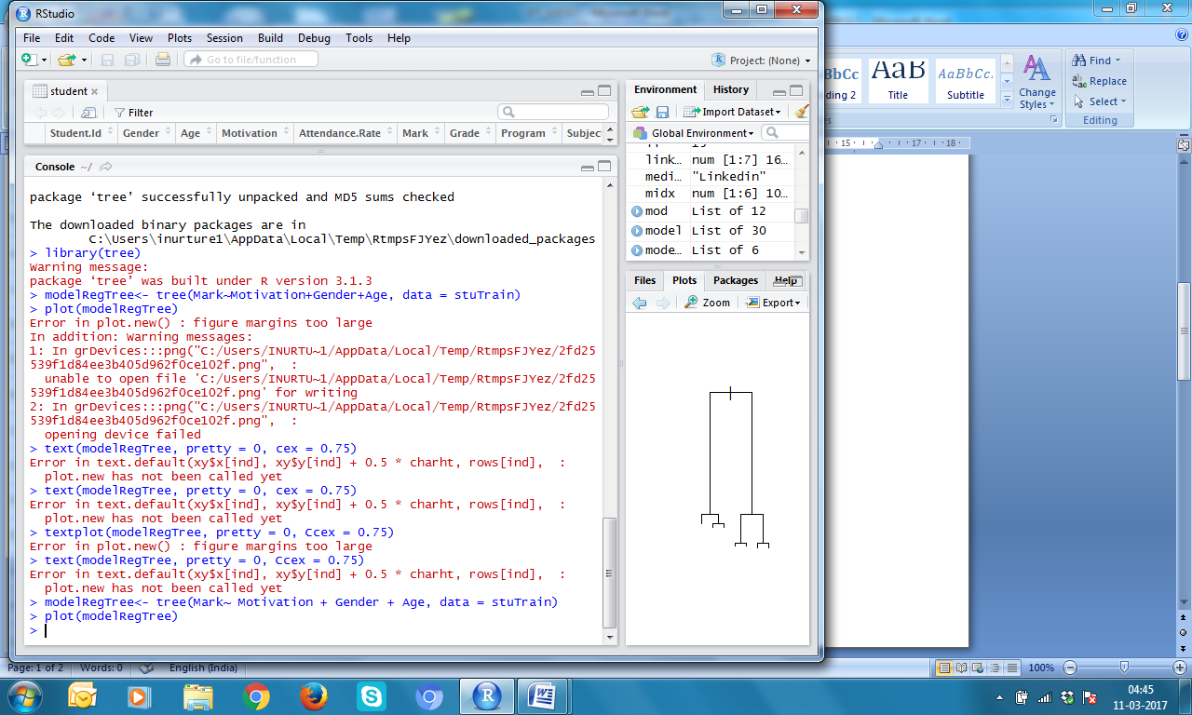
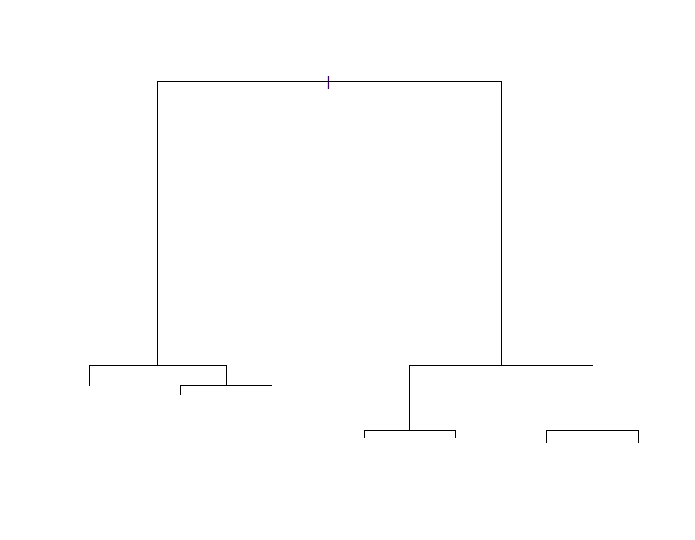

Slide 24
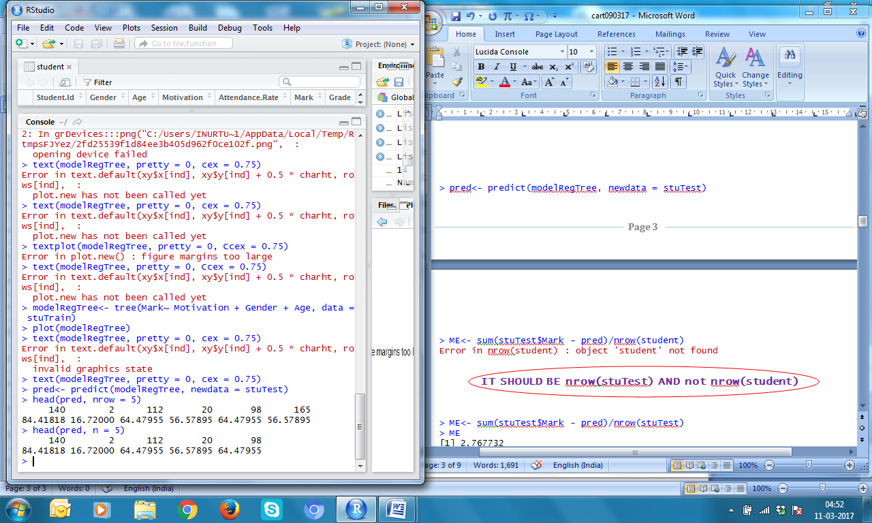
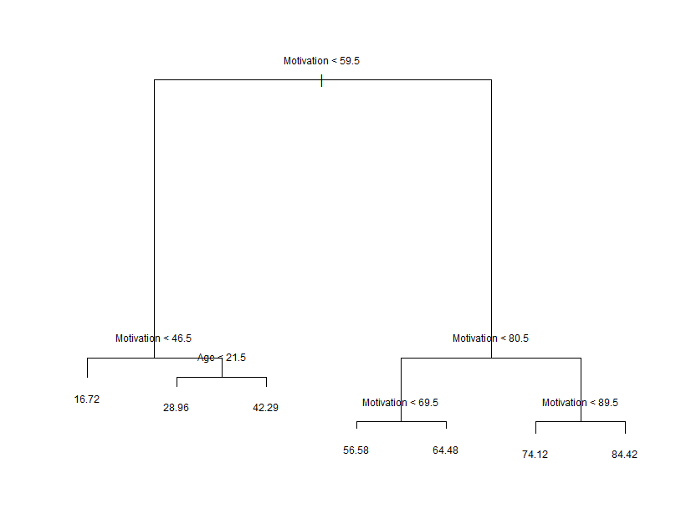

Slide 25
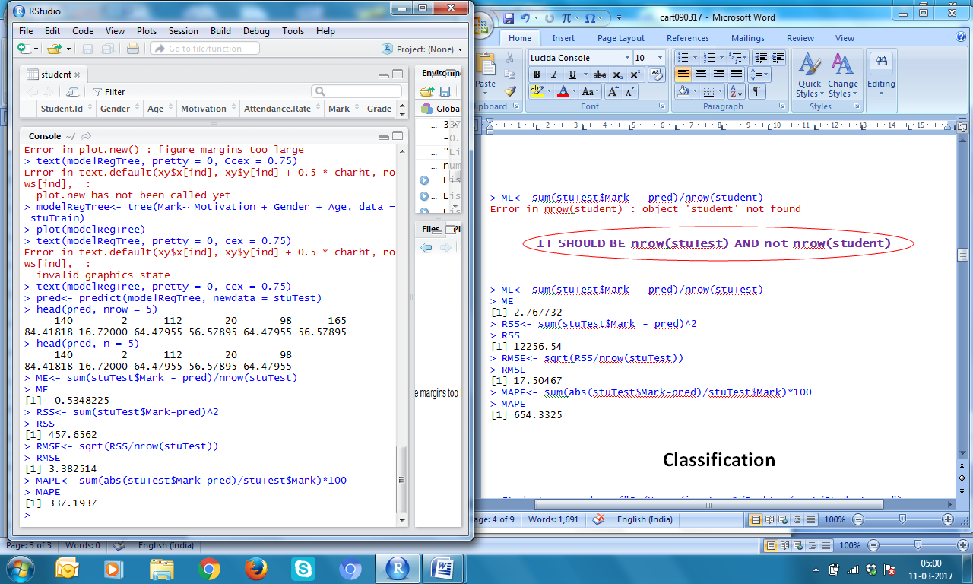

Slide 26
Classification

Slide 27
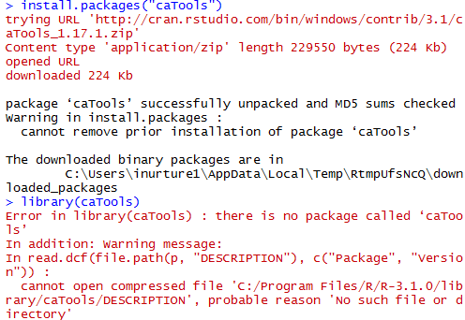

Slide 28
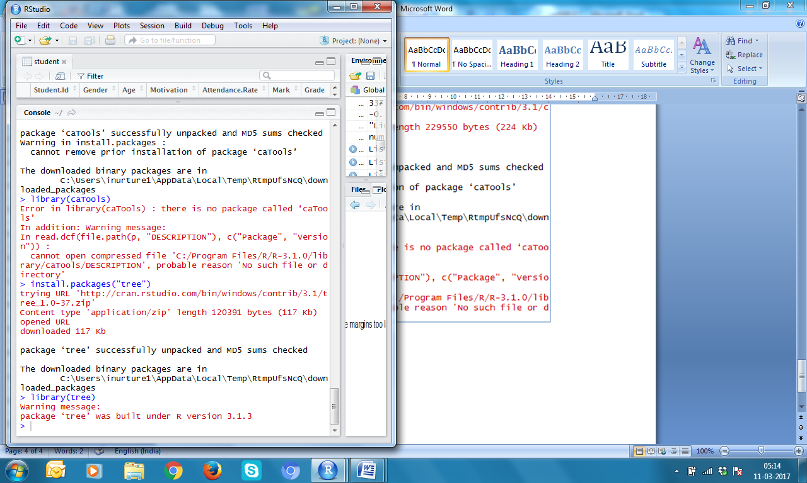

Slide 29
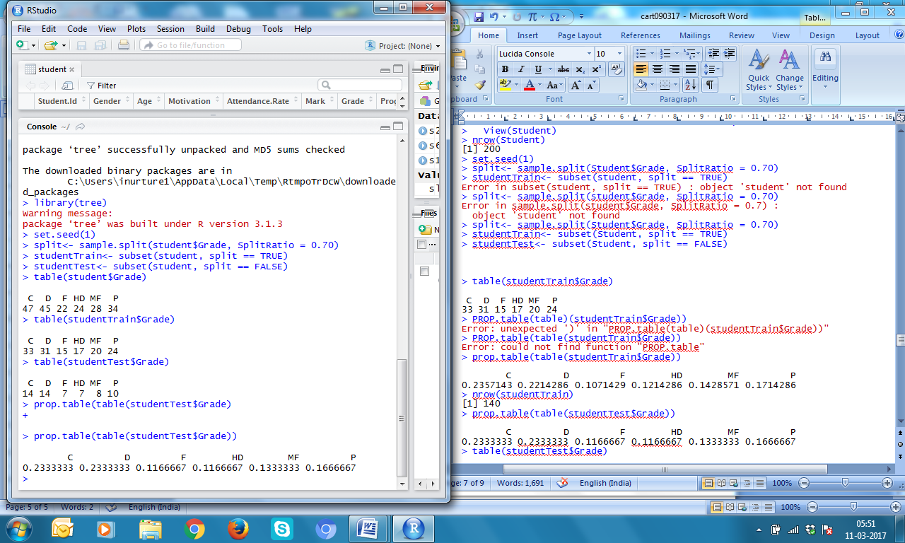

Slide 31
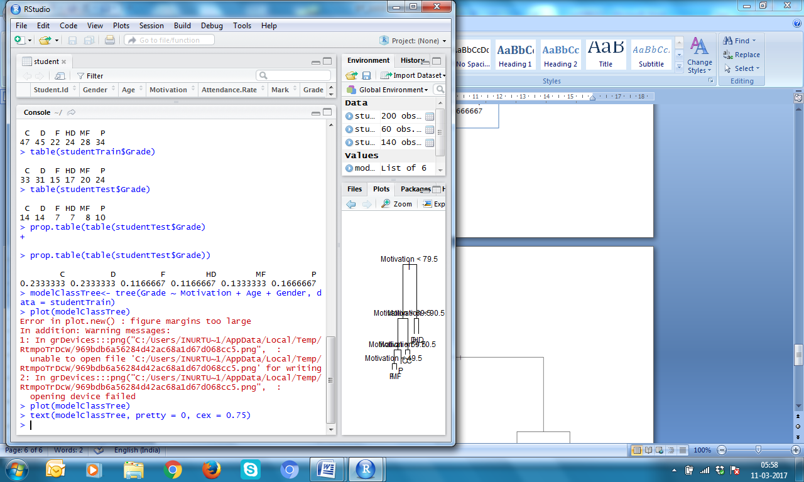
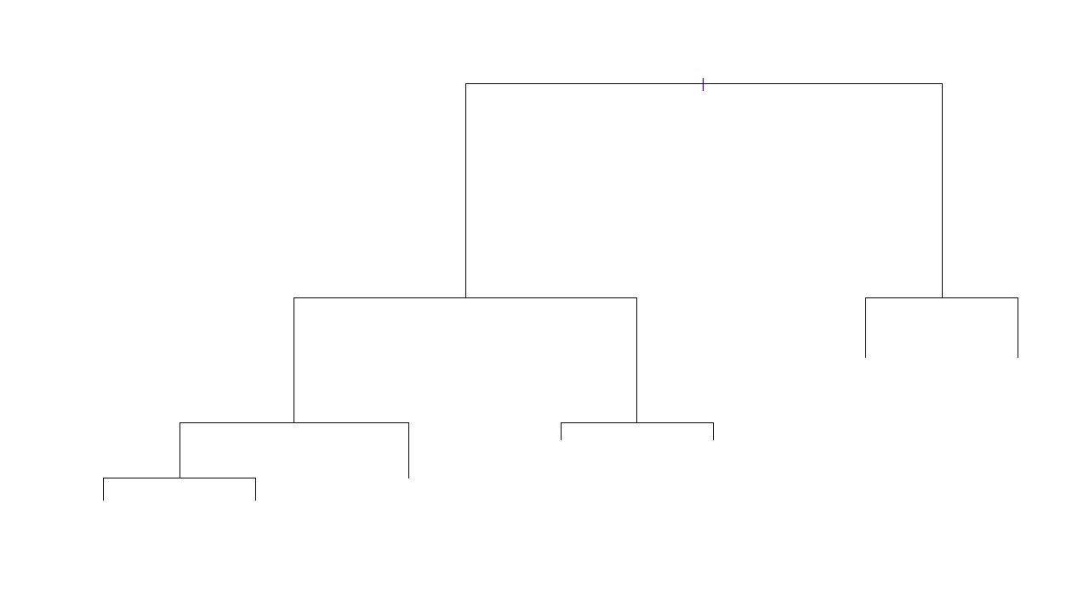

Slide 32
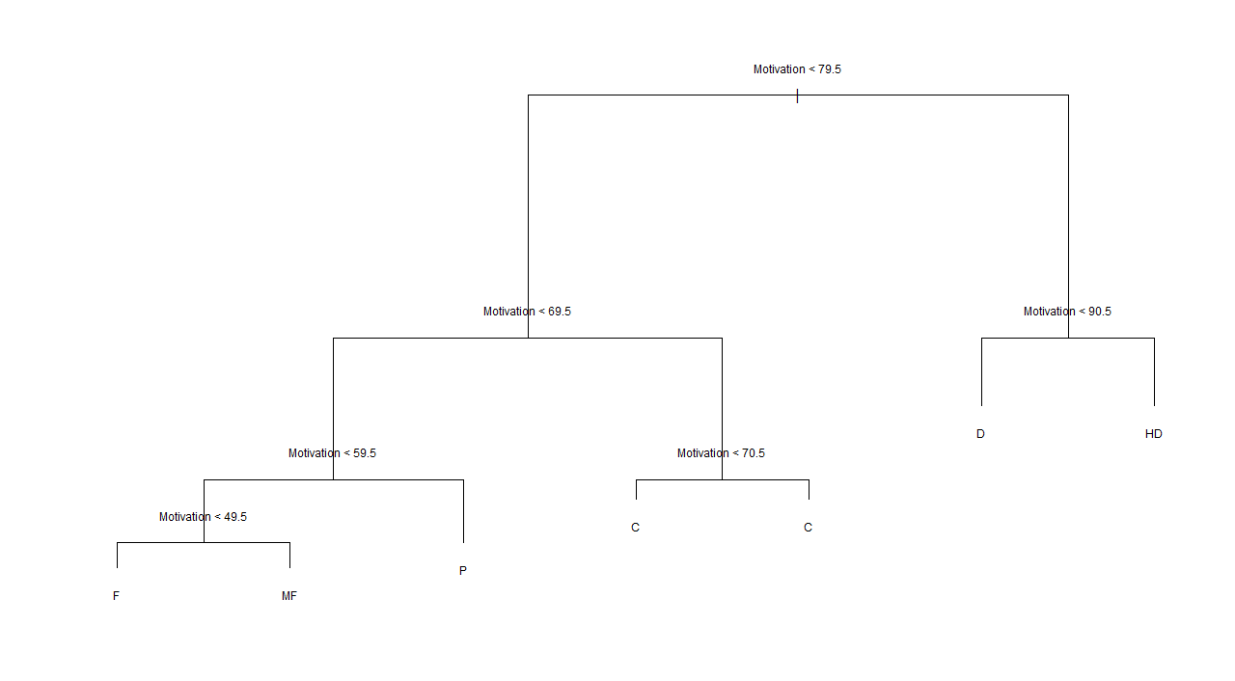

Slide 33
